Slide 1
POLYNOMIALS CLASS – X

Slide 2
Introduction
In class IX, you have studied polynomials in one variable and their degrees. Recall that if p(x) is a polynomial in x, the highest power of x in p(x) is called the degree of the polynomial p(x). Few examples are:
POLYNOMIAL | DEGREE
NOTE : Expressions like $\frac{1}{x−1}$ , $\sqrt{x }+2$ , $\frac{1}{x^{2}−2x+3}$ etc., are not polynomials.

Slide 3
TYPES OF POLYNOMIALS
TYPE | NAME | EXAMPLES | GENERAL FORM
A polynomial of degree 1 | Linear polynomial | 2x – 3 , y +$\sqrt{2}$ , $\frac{2}{3} u+3$ , etc., | ax+b ; where a and b are real numbers and a≠0
A polynomial of degree 2 | Quadratic polynomial | y² – 2 , 2x²+ 3x-1/2 , $\sqrt{5} v^{2}−\frac{2}{3} v$, etc., | ax²+bx+c ; where a,b and c are real numbers and a≠0
A polynomial of degree 3 | Cubic polynomial | 2 – x³ , $\sqrt{5} v^{3}$, 3x³- 2x²+x-1, etc., | ax³+bx²+cx+d ; where a,b,c and d are real numbers and a≠0
LET’S RECALL……
Consider the polynomial, $p\left(x\right)= x^{2}−3 x−4$
on putting, $x=2 , we get, p\left(2\right)= 2^{2}−3\left(2\right)−4= −6$; -6 is the value of $p\left(x\right)$ at $x=2$
on putting, $x=0 , we get, p\left(0\right)= 0^{2}−3\left(0\right)−4= −4$; -4 is the value of $p\left(x\right)$ at $x=0$

Slide 4
TYPES OF POLYNOMIALS
In general , if p(x) is a polynomial in x, and if k is any real number, then the value obtained by replacing x by k in p(x), is called the value of p(x) at x=k, and is denoted by p(k).
Let us take another polynomial p(x) = x² – 3x – 4
Here, p(-1) = (-1)² – 3(-1) – 4 = 0 and p(4) = (4)² – 3(4) – 4 = 0 ; - 1 and 4 are called the zeroes of the quadratic polynomial x² – 3x – 4
In general, a real number k is said to be a zero of a polynomial p(x), if p(k)=0
You have studied in class IX, how to find the zeroes of a linear polynomial. For example, if k is a zero of p(x) = 2 x + 3, then p(k) = 0 gives 2 k + 3 = 0 , that is , k = - 3/2.
In general, if k is a zero of p(x) = a x + b , then p(k) = a k + b = 0 gives, k = - b/a
So, the zero of the linear polynomial a x + b is – b / a = - ( constant term )/( coefficient of x )

Slide 5
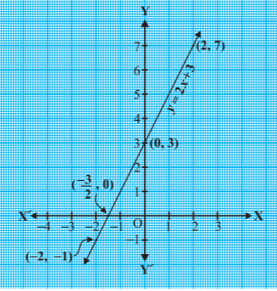
GEOMETRICAL MEANING OF ZEROES OF A POLYNOMIAL
A real number k is a zero of the polynomial p(x) if p(k)=0.
Consider first, a linear polynomial ax + b , a≠0. You have studied in class IX that the graph of y=ax + b is a straight line.
For example, the graph of y = 2x + 3 is a straight line passing through the points ( -2 , - 1) and ( 2 , 7 ).
Here, we can see that graph of y=2x + 3 intersects x-axis at (-3/2 , 0). We also know that the zero of 2x+3 is -3/2. Thus, the zero of 2x+3 is the x- coordinate of the point where the graph of y = 2x + 3 intersects x – axis

Slide 6
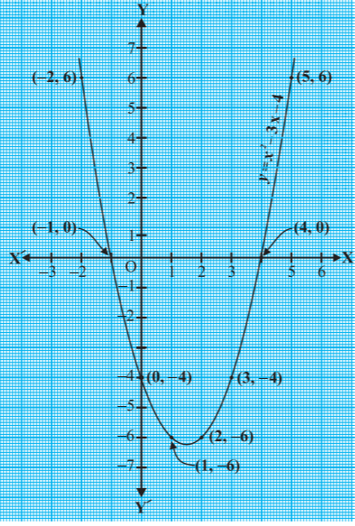
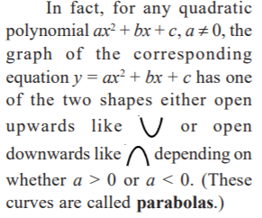
GEOMETRICAL MEANING OF ZEROES OF A POLYNOMIAL
In general, for a linear polynomial ax + b , a≠0, the graph of y=ax+b is a straight line which intersects the x-axis at exactly one point , namely (-b/a , 0 ).
Therefore, the linear polynomial ax + b , a≠0,has exactly one zero, namely, the x-coordinate of the point where the graph of y=ax+b intersects the x-axis.
Now, let us talk about the geometrical meaning of zero of a quadratic polynomial.
Consider the quadratic polynomial x² - 3x – 4.Let us draw the graph of y = x² - 3x – 4

Slide 7
GEOMETRICAL MEANING OF ZEROES OF A POLYNOMIAL
You can see from the above table that – 1 and 4 are zeroes of the quadratic polynomial. Also, note that , from the graph, - 1 and 4 are the coordinates of the points where the graph of y = x² - 3x – 4 intersects the x-axis.
Thus, the zeroes of the quadratic polynomial x² - 3x – 4 are the x-coordinates of the points where the graph of y = x² - 3x – 4 intersects the x-axis.
The zeroes of the quadratic polynomial ax²+bx+c, a≠0, are precisely the x-coordinates of the points where the parabola representing y = ax²+bx+c intersects the x-axis.

Slide 8
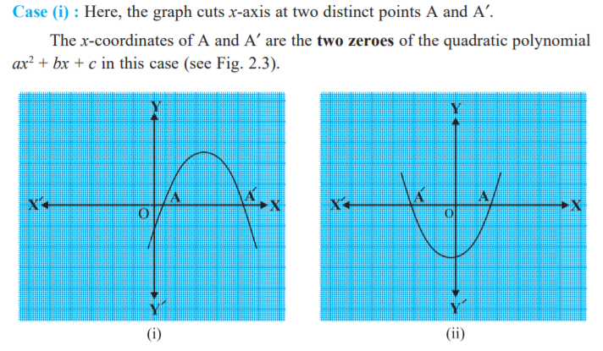
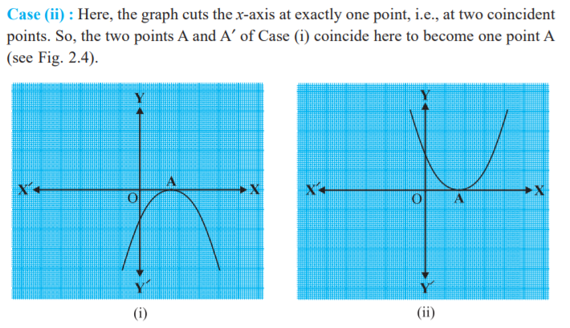
GEOMETRICAL MEANING OF ZEROES OF A POLYNOMIAL
From our observation following three cases can happen

Slide 9
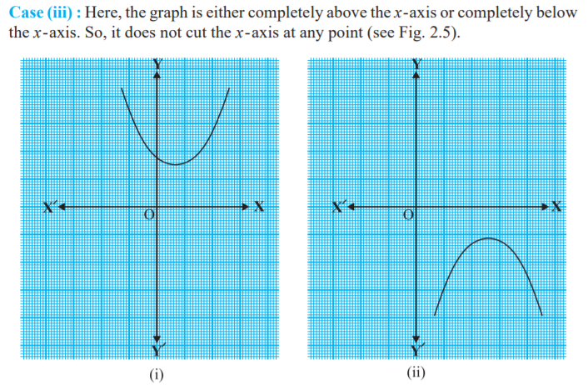
GEOMETRICAL MEANING OF ZEROES OF A POLYNOMIAL

Slide 10
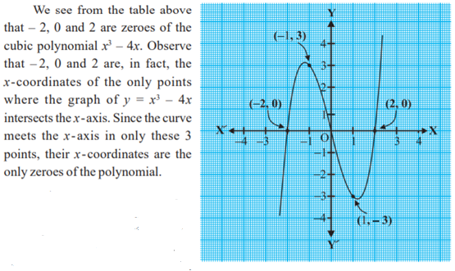
ZEROES OF A CUBIC POLYNOMIAL
Consider a cubic polynomial x³ – 4 x. To see the graph of y = x³ – 4 x, let us list a few values of y corresponding to a few values of x as shown in the table below:
Locating the points of the table on the graph paper and drawing the graph, we see that the graph of y = x³ – 4 x actually looks like the one given below:

Slide 11
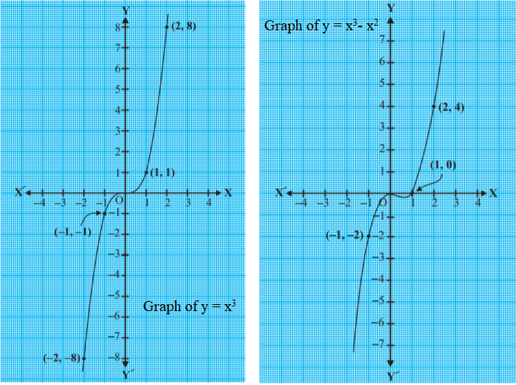
ZEROES OF A CUBIC POLYNOMIAL
Now, consider the cubic polynomials x³ and x³- x². We draw the graphs of y = x³ and y = x³- x²
OBSERVATIONS:
0 is the only zero of the polynomial x³. So, 0 is the x-coordinate of the only point where the graph of y = x³ intersects the x-axis.
x³- x² = x²( x – 1 ) , 0 and 1 are the zeroes of the polynomial x³- x². So, 0 and 1are the only points where the graph of y = x³- x² intersects the x-axis.
REMARK:
In general, given a polynomial p(x) of degree n, the graph of y=p(x) intersects x-axis at atmost n points. Therefore, a polynomial p(x) of degree n has atmost n real zeroes.

Slide 12
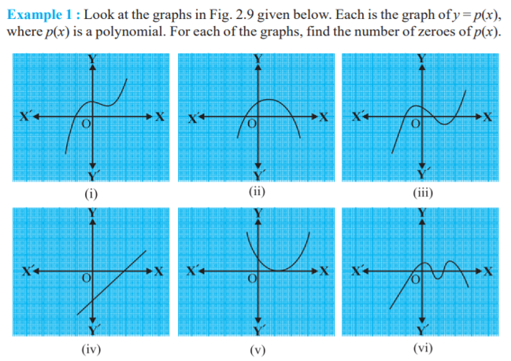
Solution:
The number of zeroes is 1 as the graph intersects the x-axis at one point only.
The number of zeroes is 2 as the graph intersects the x-axis at two points
The number of zeroes is 3. (Why?)
The number of zeroes is 1. (Why?)
The number of zeroes is 1. (Why?)
The number of zeroes is 4. (Why?)

Slide 13
Videos:
https://youtu.be/XAuAH64puJU : VIDEO ON ZERO OF A LINEAR POLYNOMIAL
https://youtu.be/s-AlezS1ByQ : VIDEO ON ZERO OF A QUADRATIC POLYNOMIAL
https://youtu.be/bSzmfUdBp2w : VIDEO ON ZERO OF A CUBIC POLYNOMIAL

Slide 14
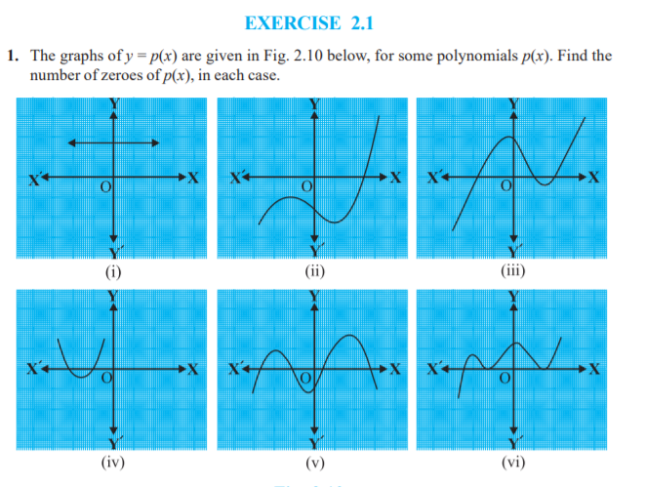
PRACTICE QUESTIONS: DO EXERCISE 2.1 IN YOUR REGISTER

